Slide 1
Efficient Web-based Software Project Monitoring, Tracking and Control System

Slide 2
Team and Guide members
Team members Guide name
Sowmiya.R Mrs.Dhanalakshmi.B,
Haripriya.N Assistant professor.
Iswarya.K

Slide 3
Problem statement
The project managers, ensure that products or services delivered to customers, meet their expectations for better quality and satisfaction.
Statistical Process Control is the use of statistical tools and techniques to analyze a process or its outputs to control, manage, and improve the quality of the output or the capability of the process .

Slide 4
Abstract
Project Monitoring Tracking, and Controlling system provides a highly-standardized , automated technique of project management, planning management and budget across a diverse group of activities of employees.
This system oversees all the tasks and metrics necessary to ensure that the approved and authorized project is within scope, on time, and on budget so that the project proceeds with minimal risk.
Monitoring of each project progress status as compared to the planned project progress.

Slide 5
Literature survey
Work time management system
WTM is an application presenting an example of usage popular and open Web technologies accessible on the Internet.
Web technologies used in the application are divided in two main groups.
The architecture of the WTM application is based on the MVC design pattern (model, view, controller), which provides a division of the project on a layer of view, layer of view and layer of controller. Such a division supports ease of further modification and improvement of functionality.

Slide 6
Analytical expense management system
Although the development of communication technologies allowed the elaboration of multiple users' Web applications (e.g. information storage), there are still many improvements on many applications to be done and uncovered areas.
Expense management systems on Web application area are still in their infancy.
Expense management software is widely spread in companies and most of time supported by their intranet.

Slide 7
Big Data Real-Time Processing
As the growth of Internet, Cloud Computing, Mobile Network and Internet of Things is increasing rapidly, Big Data is becoming a hot-spot in recent years.
Big Data Processing is involved in our daily life such as mobile devices, RFID and wireless sensors, which aims at dealing with billions of users' interactive data.
At the same time, real-time processing is eagerly needed in integrated system.

Slide 8
Modules
Admin module
Employee Module
Project module
Reports
Task
Time Tracking

Slide 9
Admin Module
The details of the manager project information will be updated in the server.
For consuming necessary time, keeping all troubles less, and to organize all documents into one place and most important , to keep track of projects that are in production for customers or for keeping an eye on errors or mistakes that occur during the work process, then a good web based management system

Slide 10
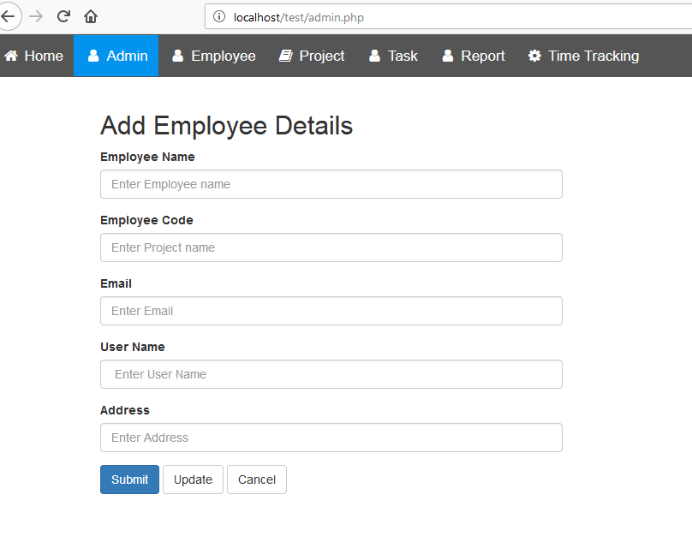

Slide 11
Employee Module
The employee personal and official details are registered for project allocation based on the skillset of the employee.
Each employee is allocated with specific id and it will be easier to track the employee time sheet work allotment.

Slide 12
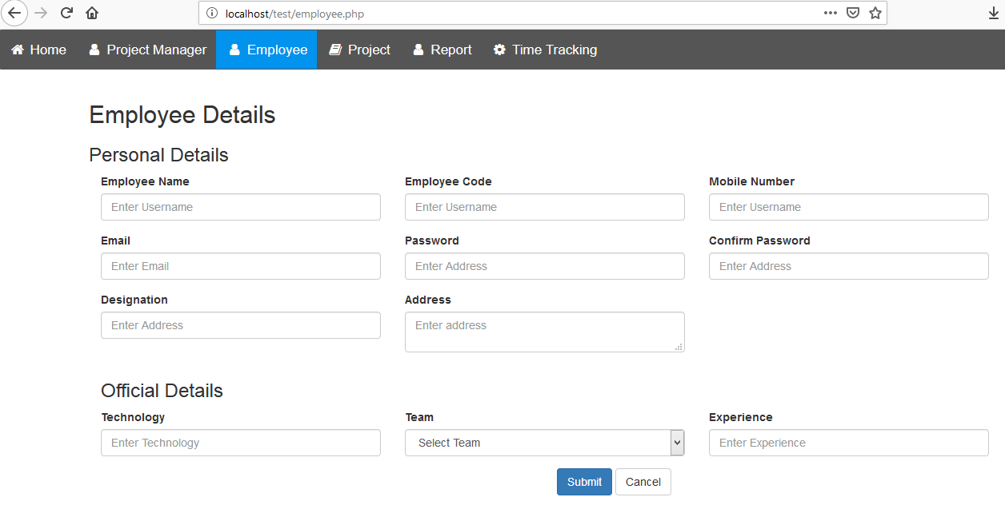

Slide 13
Project Module
The project allocation is performed based on the projects and the employee availability and skillset and duration of the project.
The time allocation is also performed in the scheduling process.
The complete work scheduling process is finalized with term of the client modules.

Slide 14
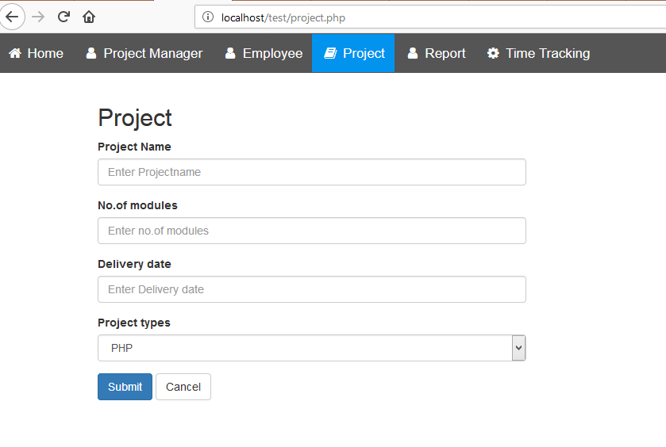

Slide 15
Reports
The web application will help to arrange reports management inside company, by keeping documents in one centralized server.
The system is web-based; there is a possibility to add documents/specifications for the specific project.

Slide 16
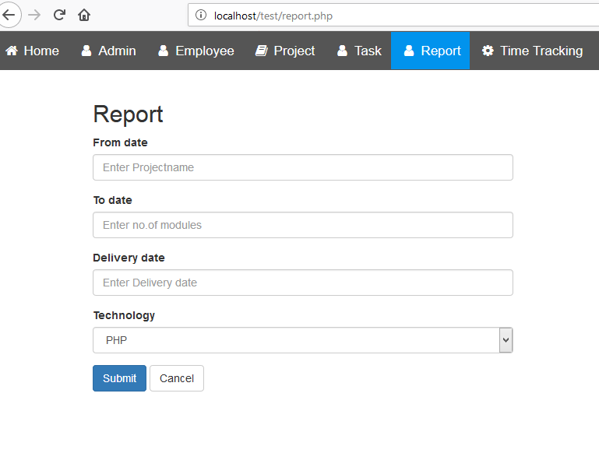

Slide 17
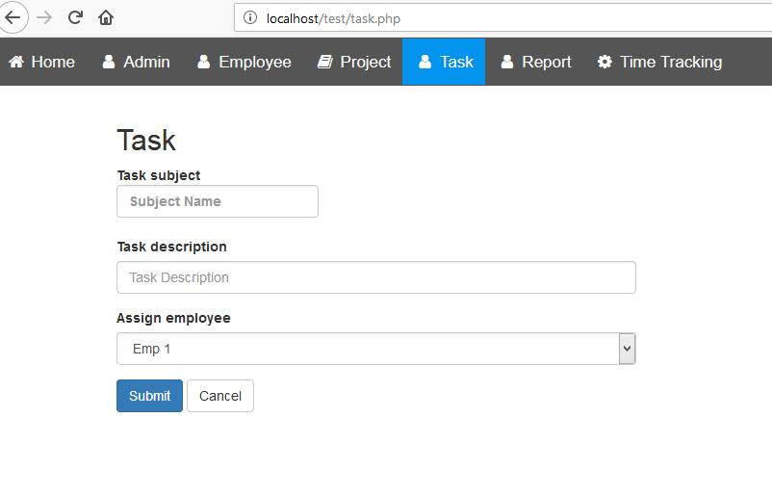
Task Module

Slide 18
Time Tracking
A smart time tracking web application for individuals and/or teams, to see how much time employee spends on client project, task and/or activity.
See individual time in the reports, which user can filter and group by client, project, etc.

Slide 19
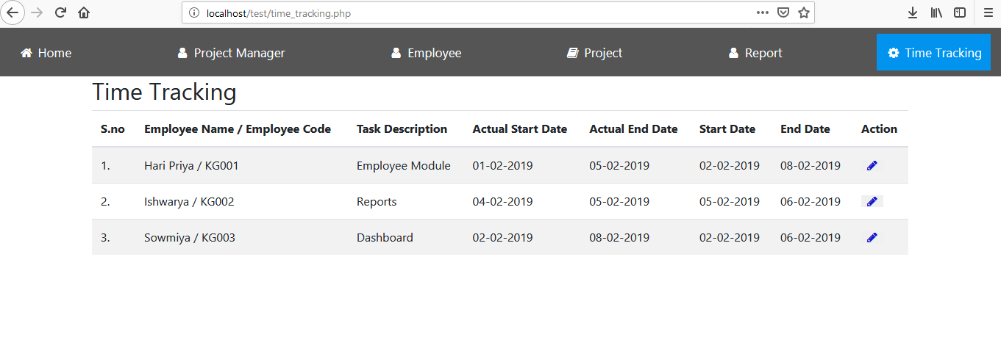

Slide 20
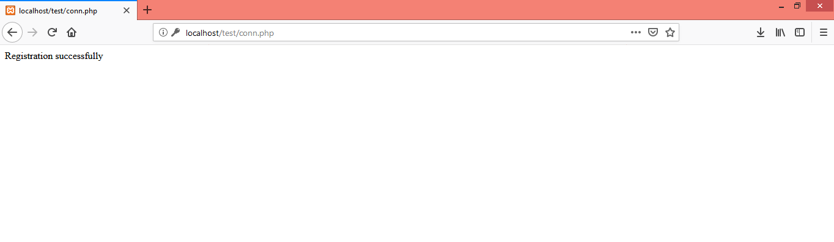

Slide 21
Architecture Diagram
Employee details
Project Allocation
Project module load entry
Project module allocation
Project work load process
Employee work time entry

Slide 22
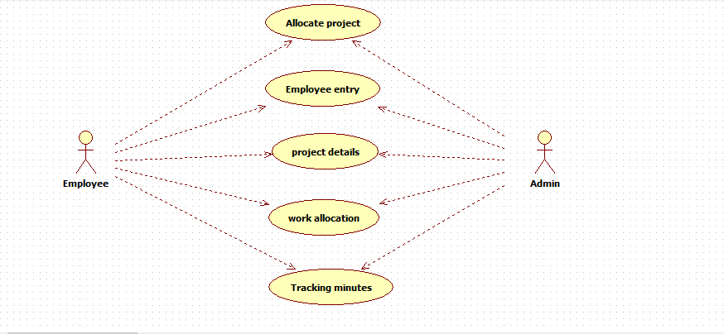
Use case Diagram

Slide 23
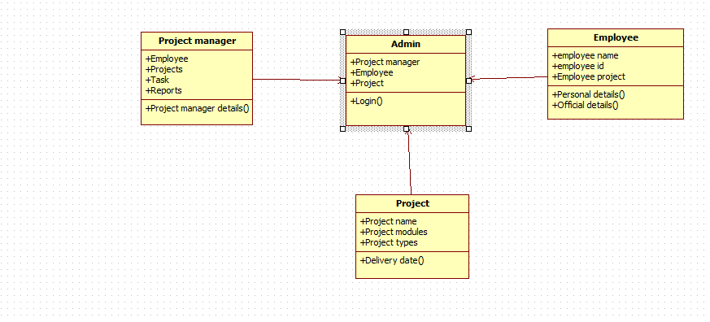
Class Diagram

Slide 24
E-R Diagram
Project name
Client code
Client name
Client password
Id
Client name
Project description
Project
Project requirement
Client
Admin name
Project
Admin password
Project scheduling
Project scheduling
Admin
Employee
Project name
Employee
Duration
Qualification
Start time
End time analysis
Employee id
Employee password
Employee name

Slide 25
Requirement Analysis
HARDWARE REQUIREMENTS
PROCESSOR : Intel Pentium I3
MOTHERBOARD : lntel 915GVSR chipset board
RAM : 1 GB DDR2 RAM
HARD DISK DRIVE : 250 GB

Slide 26
SOFTWARE REQUIREMENTS
FRONT END : HTML , PHP
BACK END : MYSQL
Client Side Script : JavaScript
Style Sheet : CSS3
Responsive Design : Bootstrap4
OPERATING SYSTEMS : Microsoft windows 7

Slide 27
Conclusion
Time track system manages the operation of the employee work system.
The project status can be easily tracked with the help of the web based application with centralized web based server.
The chart report with the metrics can be managed ,with easy to measure the project system.

Slide 28
Any Queries?

Slide 29
Thank you!

